Slide 1
Lab 2

Slide 2
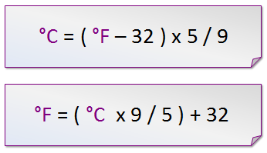
Fahrenheit to Celsius

Slide 3
Recursion example (factorial)
public class FactorialRecursive {
public static long recFact(int n){
if (n<=1)
return 1;
else
return n*recFact(n-1);
}
public static void main(String args[]){
System.out.println(recFact(80));
}
}

Slide 4
Euclid’s algorithm for GCD
function gcd(a, b)
begin
while a ≠ b
if a > b
a := a − b;
else
b := b − a;
return a;
end

